Slide 1
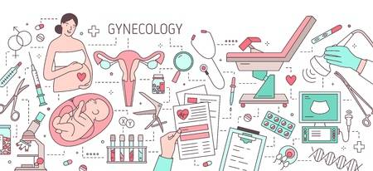
Abnormal Uterine Bleeding-Functional Etiology

Slide 6
شرح حال
معاینه
تصویر برداری
آزمایشَ

Slide 7
Ovulatory Dysfunction

Slide 9
Estrogen Withdrawal Bleeding
Estrogen Withdrawal Bleeding

Slide 10
Estrogen Withdrawal Bleeding
Oophorectomy
MittelSchmerz

Slide 11
Estrogen Breakthrough Bleeding

Slide 12
Estrogen Breakthrough Bleeding
Anovulation

Slide 13
Progestogen Withdrawal Bleeding

Slide 14
Progestogen Withdrawal Bleeding
Extraction of corpus luteum
Luteal Phase deficiency

Slide 15
Progestogen Breakthrough Bleeding

Slide 16
Progestogen Breakthrough Bleeding
OCP
Mirena
Depo-MDPA

Slide 17
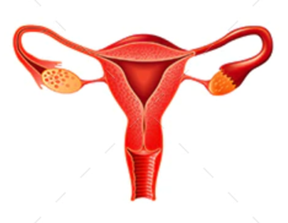
خانم 30 ساله 5 سال مصرف OCP مراجعه با خونریزی حین مصرف قرص

Slide 18
دختر 17 ساله با منس نامنظم و الیگومنوره

Slide 19
دختر 17 ساله با الیگومنوره و منس نامنظم با 15 روز خونریزی شدید و هموگلوبین 8

Slide 20
خانم 45 ساله با منس نامنظم سونوگرافی نرمال ضخامت اندومتر 7 میلیمتر آزمایشات نرمال

Slide 21
خانم 28 ساله زایمان دوماه قبل خونریزی مداوم که کم و زیاد میشود در سونو ضخامت اندومتر 3 میلیمتر ازمایشات نرمال

Slide 22
Functional Causes of AUB
Infections such as cervicitis, endometritis, and salpingitis
adenomyosis
malignancies of the cervix and endometrium.
thyroid disorder (hypothyroidism or hyperthyroidism).
coagulopathy
medications

Slide 23
Functional Causes of AUB
systemic illnesses:
diabetes mellitus
systemic lupus erythematosus
malignancy, and myelodysplasia
Chronic renal disease is associated with both ovulatory and platelet dysfunction. Liver disease
In adolescents, genital trauma, sexual abuse, cervicitis relating to sexually-transmitted infections (Chlamydia trachomatis), and foreign bodies (e.g., retained tampons) merit specifi c consideration.

Slide 25
History
: Intermenstrual interval (number of days, regularity)
Volume (heavy, light, or variable)
Duration (normal or prolonged, consistent or variable)
Onset of abnormal menses (perimenarcheal, sudden, gradual)
Temporal associations (postcoital, postpartum, post-pill, weight gain or loss)
Associated symptoms (premenstrual molimina, dysmenorrhea, dyspareunia, galactorrhea, hirsutism)
Underlying systemic illness (renal, hepatic, hematopoietic, thyroid)
Medications (hormonal, anticoagulants)

Slide 26
In the majority of women with true anovulatory bleeding, the menstrual history alone can establish the diagnosis with sufficient confidence that treatment can begin without additional laboratory evaluation or imaging.

Slide 27
pregnancy test
complete blood count
serum progesterone
chlamydia and gonorrhea and a wet prep
thyroid-stimulating hormone (TSH)
Liver or renal function tests are indicated only for those with known or strongly suspected disease.
coagulation studies

Slide 28
ممنون از توجه شما

